Slide 1
Movies part 3
Barb Ericson
Georgia Institute of Technology
April 2006

Slide 2
Learning Goals
Media Goals
  To generate a frame-based animation by moving an image in a series of frames
  To generate a fake sunset movie by reducing more blue and green in each frame
Computing Concepts
  To add parameters to methods to make them reusable
  To reuse earlier methods in making movies

Slide 3
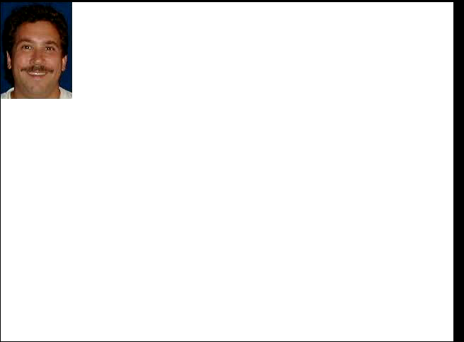
Moving Images in Movies
You can copy an image to a picture
  Using our general copy method
    Or using graphics.drawImage
Copy the image to different locations
  In each frame
Notes:
This mpeg file was created with ImageMagick using
convert –adjoin –border 1 –bordercolor black frame*.jpg frame.mpeg
Click on the movie to play it.

Slide 4
Code for Move Mark's Head Movie
public void moveMarksHead(String directory)
{
// load the picture of Mark
String fName = FileChooser.getMediaPath(
"blue-Mark.jpg");
Picture markP = new Picture(fName);
// declare other variables
Picture target = null;
FrameSequencer frameSequencer =
new FrameSequencer(directory);
int framesPerSec = 30;

Slide 5
Code for Move Mark's Head Movie - Cont
// loop creating the frames
for (int i = 0; i < framesPerSec; i++)
{
target = new Picture(640,480);
target.copy(markP,281,164,382,301,i * 10, i * 5);
frameSequencer.addFrame(target);
}
// play the movie
frameSequencer.play(framesPerSec);
}

Slide 6
Main for Testing
public static void main(String[] args)
{
MovieMaker movieMaker = new MovieMaker();
String dir = "c:/intro-prog-java/movies/mark/";
movieMaker.moveMarksHead(dir);
}
Notes:
You can change the directory to any empty directory.

Slide 7
Exercises
Create new methods in MovieMaker
Make the turtle in turtle.jpg crawl across the beach in beach.jpg
  Add a new copy method that copies non-white pixels only
Make the robot in robot.jpg move across the moon in moon-surface.jpg

Slide 8
Reusing Picture Methods
We can reuse picture methods from previous chapters
  To create a movie
To create a sunset movie
  Create a new makeSunset method
    That takes as a parameter the amount to reduce the blue and green in the picture
    Reuse the same picture to accumulate the effect
  Remember that you can have two methods with the same name
    As long as the parameter lists are different

Slide 9
Make Sunset Method
public void makeSunset(double reduction)
{
Pixel[] pixelArray = this.getPixels();
Pixel pixel = null;
int value = 0;
int i = 0;
// loop through all the pixels
while (i < pixelArray.length)
{

Slide 10
Make Sunset Method - Cont
// get the current pixel
pixel = pixelArray[i];
// change the blue value
value = pixel.getBlue();
pixel.setBlue((int) (value * reduction));
// change the green value
value = pixel.getGreen();
pixel.setGreen((int) (value * reduction));
// increment the index
i++;
}
}

Slide 11
Code for Sunset Movie
public void makeSunsetMovie(String directory)
{
// load the picture of the beach
String fName = FileChooser.getMediaPath(
"beach-smaller.jpg");
Picture beachP = new Picture(fName);
// declare other variables
Picture target = null;
FrameSequencer frameSequencer =
new FrameSequencer(directory);
int framesPerSec = 30;

Slide 12
Code for Sunset Movie - Cont
// loop creating the frames
for (int i = 0; i < framesPerSec; i++)
{
beachP.makeSunset(0.95);
frameSequencer.addFrame(beachP);
}
// play the movie
frameSequencer.play(framesPerSec);
}

Slide 13
Main for Testing
public static void main(String[] args)
{
MovieMaker movieMaker =
new MovieMaker();
String dir =
"c:/intro-prog-java/movies/sunset/";
movieMaker.makeSunsetMovie(dir);
}
Notes:
You can change the directory that you write the frames to.

Slide 14
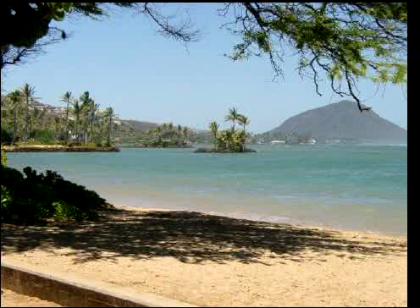
Fake Sunset Movie
Notes:
This mpeg file was created with ImageMagick using
convert –adjoin –border 1 –bordercolor black frame*.jpg frame.mpeg
Click on the movie to play it.

Slide 15
Exercise
Create a new method in MovieMaker
Make a movie where two pictures blend by different amounts over time
  Increase the amount of one picture over time
  As you decrease the amount of the other picture over time
See blendPictures in Picture.java as a starting point
  Add parameters for the pictures to blend and the amount of each picture to use

Slide 16
Summary
You can move a picture by copying it a different location in each frame
You can fake a sunset by removing more blue and green in each frame
Adding parameters to methods makes them more reusable
You can have several methods with the same name in the same class
  The parameter list must be different!

